Slide 1
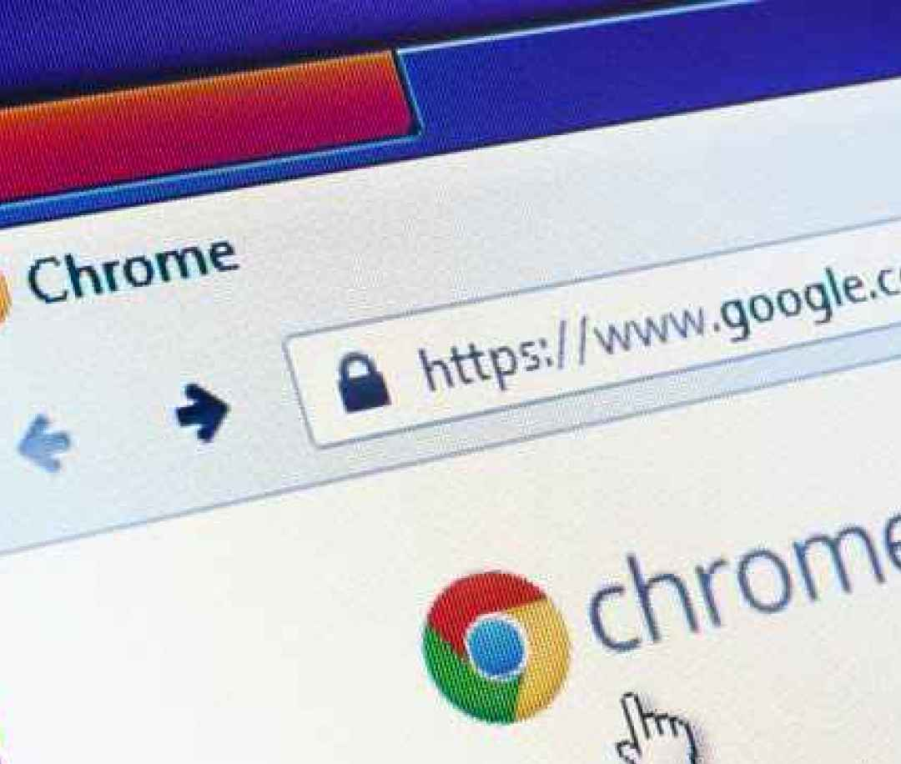
Lecture 2: How Browsers Work
Eng / Youssef khaled
Backend Roadmap
ThePhoto by PhotoAuthor is licensed under CCYYSA.

Slide 2
What is a Web Browser?
A web browser is a program that lets you view websites.
It retrieves, presents, and navigates the web.
Examples: Google Chrome, Firefox, Safari.

Slide 3
How Do Browsers Work?
Browsers send requests to web servers to get web pages.
They display the web pages on your screen after receiving the data.
Example: Typing a URL in your browser to load a website.

Slide 4
The Request-Response Cycle
1. You enter a URL.
2. The browser sends a request to a server.
3. The server sends back the webpage data.
4. The browser displays the page.
Example: Browser requests data; server responds with HTML.

Slide 5

What is HTML?
HTML (Hypertext Markup Language) is the language used to structure web pages.
Browsers read HTML to know what to display on the page.
Example: Text, images, links.

Slide 6

What is CSS?
CSS (Cascading Style Sheets) is used to style web pages.
It tells the browser how elements should look (color, layout, fonts).
Example: Changing the color of text to blue with CSS.

Slide 7

What is JavaScript?
JavaScript is a programming language that makes web pages interactive.
Browsers execute JavaScript to allow users to interact with the page.
Example: Click a button to show or hide content.

Slide 8

Rendering a Web Page
Rendering is how a browser turns HTML, CSS, and JavaScript into a web page.
The browser renders elements in the correct order to display them properly.
Example: Text appears before images while the page loads.

Slide 9

What is a Cookie?
Cookies are small pieces of data stored by your browser.
They help websites remember your information (login details, preferences).
Example: Staying logged in to a website after closing the browser.

Slide 10

Browser Developer Tools
Browsers have tools for debugging and testing web pages.
They help developers inspect HTML, CSS, and JavaScript.
Example: Using Chrome Developer Tools to check why an image isn't loading.

Slide 11

Summary
- Browsers send requests to servers and receive web pages.
- HTML, CSS, and JavaScript are used to build web pages.
- Browsers render web pages and store cookies to remember user data.

